Slide 1
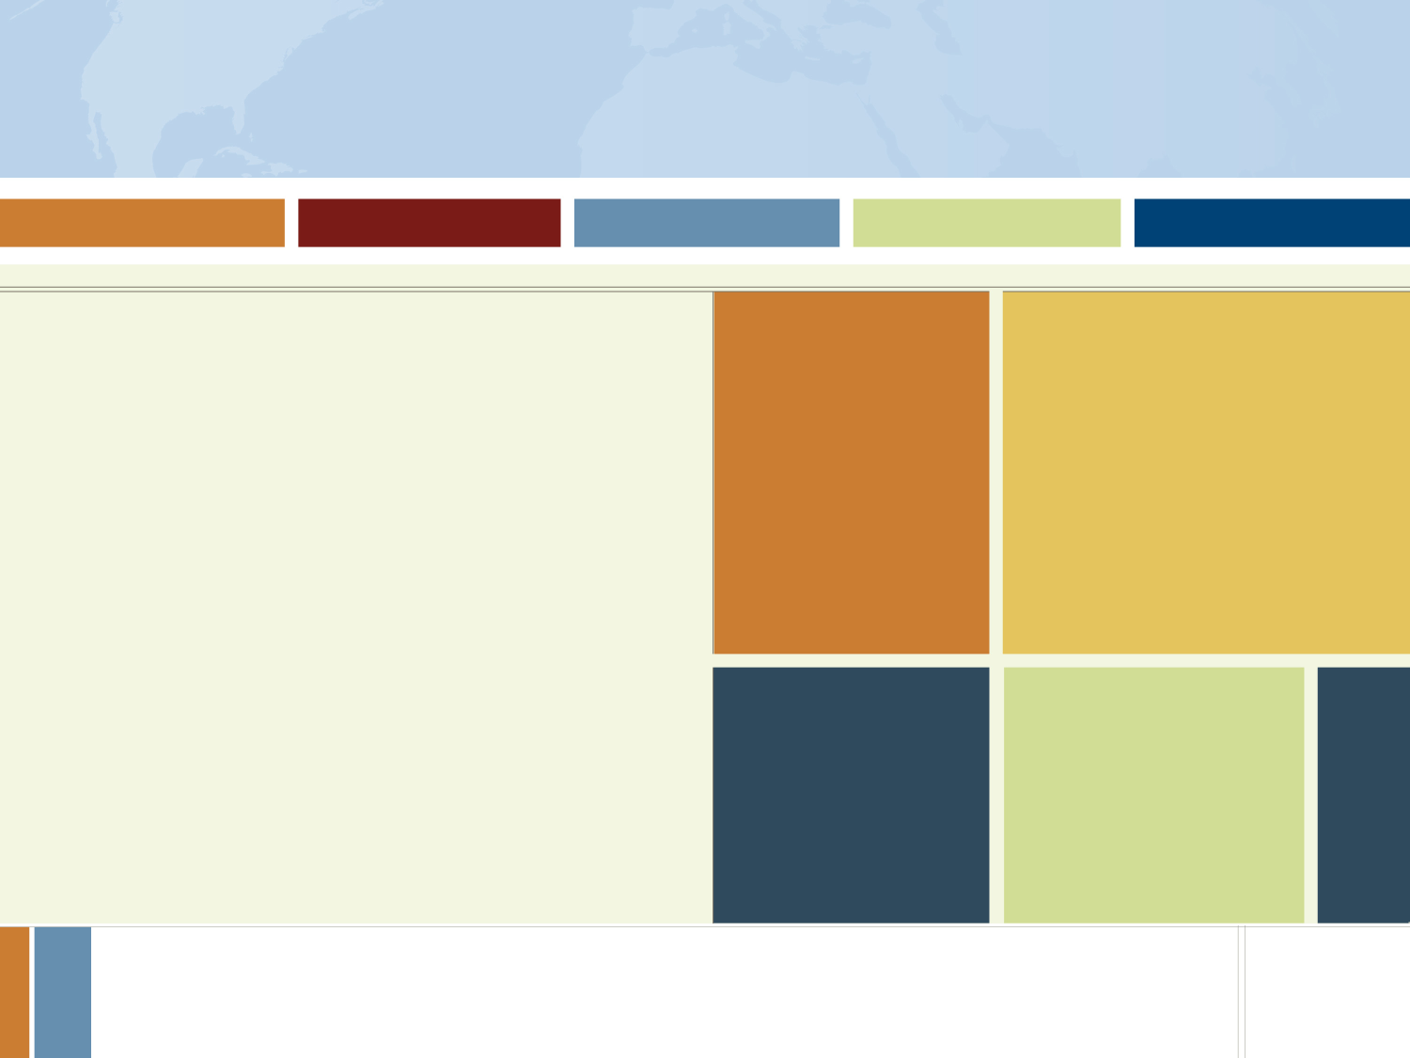


Graduate Writing Center: gwrc@ucr.edu
Individual Consultations
Online resources (pre-writing, worksheets, etc.)
Fulbright Student Program Website: us.fulbrightonline.org
Updated guidelines
Pre-writing prompts
Country specific information
Director, UCR GradSuccess: Maggie Gover, maggie.gover@ucr.edu, (951)
Position Yourself for Success
Start thinking now about which countries you might be interested in
Then do your research
  Form: Dominica is suspended due to hurricane season
  What now? Other coffee-producing countries
  Indonesia: undersubscribed, minimal language requirement
  Statistics: 2014-15 26%; 2015-16 23%; 2016-17 37%
  But you’ve become fluent in Spanish!
  Columbia for Study/Research:
  Statistics: 2014-15 22%; 2015-16 21%; 2016-17 20%
  Form: added 30 new ETAs
  Website: required to do social/community project as
  part of award, locations variable
^{For more information, visit:}
^{http://fulbright.state.gov}
Notes:
Combine thinking about your topic, your language abilities,which places are undersubscribed, and the parameters of specific awards to hone in on your best targets for application
Ex. Kazahkstan: Click on countries – South and Central Asia – Kazahkstan (2 open study awards); then go find under stats and shows 30% chance of receiving award

Slide 2
Graduate Writing Center: gwrc@ucr.edu
Individual Consultations
Online resources (pre-writing, worksheets, etc.)
Fulbright Student Program Website: us.fulbrightonline.org
Updated guidelines
Pre-writing prompts
Country specific information
Director, UCR GradSuccess: Maggie Gover, maggie.gover@ucr.edu, (951)
Position Yourself for Success
What are they encouraging?
Which countries in the region typically do not receive high numbers of applications?
Are multi-country awards accepted?
Is this country currently accepting your type of application?
Some countries will only accept research applications from graduate students!
Does this country accept arts applications?
Start building relationships:
If you know of the lab or the person with whom you would like to work, make contact!
Talk to your professors about wanting to apply for the Fulbright
You should start making contacts no later than June of the year in which you are applying (e.g. application due October 2018, start making contact NOW!)
^{For more information, visit:}
^{http://fulbright.state.gov}
Notes:
Handout
Western Hemisphere on website a good example for multi-country projects (https://us.fulbrightonline.org/countries/selectedregion/18)

Slide 3
Graduate Writing Center: gwrc@ucr.edu
Individual Consultations
Online resources (pre-writing, worksheets, etc.)
Fulbright Student Program Website: us.fulbrightonline.org
Updated guidelines
Pre-writing prompts
Country specific information
Director, UCR GradSuccess: Maggie Gover, maggie.gover@ucr.edu, (951)
Position Yourself for Success
Know the country limitations/requirements:
Some countries do not accept arts applications
Some countries limit the overseas experience you are allowed to already have
Some countries only accept affiliation from universities
Start thinking about Institutional Research Review (IRB) approval
If you will be interacting with people for your research (e.g. conducting interviews) you must have HRRB approval
Long process, start as early as possible
Some countries require HRRB approval to be completed prior to application, others require it to have begun, others require approval *from* that country
^{For more information, visit:}
^{http://fulbright.state.gov}

Slide 4
Graduate Writing Center: gwrc@ucr.edu
Individual Consultations
Online resources (pre-writing, worksheets, etc.)
Fulbright Student Program Website: us.fulbrightonline.org
Updated guidelines
Pre-writing prompts
Country specific information
Director, UCR GradSuccess: Maggie Gover, maggie.gover@ucr.edu, (951)
Position Yourself for Success
Plan for your Fulbright application timeline with your graduate timeline in mind.
Sample graduate timeline:
Research in year 4 to write in year 5, apply at the beginning of year 3
Years 1-2:
Coursework
Year 3:
Qualifier
Year 4-5:
Dissertation Research & Writing
^{For more information, visit:}
^{http://fulbright.state.gov}
Notes:
Maybe think about applying twice

Slide 5
Graduate Writing Center: gwrc@ucr.edu
Individual Consultations
Online resources (pre-writing, worksheets, etc.)
Fulbright Student Program Website: us.fulbrightonline.org
Updated guidelines
Pre-writing prompts
Country specific information
Director, UCR GradSuccess: Maggie Gover, maggie.gover@ucr.edu, (951)
Position Yourself for Success
Plan for your Fulbright application timeline with your graduate timeline in mind.
Sample graduate timeline:
Set-up research in year 4, research abroad while writing in year 5, apply at beginning of year 4
Years 1-2:
Coursework
Year 3:
Qualifier
Year 4-5:
Dissertation Research & Writing
^{For more information, visit:}
^{http://fulbright.state.gov}
Notes:
Remember that if you are chosen, can’t apply for this particular Fulbright award again

Slide 6
Graduate Writing Center: gwrc@ucr.edu
Individual Consultations
Online resources (pre-writing, worksheets, etc.)
Fulbright Student Program Website: us.fulbrightonline.org
Updated guidelines
Pre-writing prompts
Country specific information
Director, UCR GradSuccess: Maggie Gover, maggie.gover@ucr.edu, (951)
Resources
Graduate Writing Center - gwrc@ucr.edu
Individual writing consultations
Written and online resources (Fulbright worksheets, link to workshop sign-ups, etc.)
Fulbright Student Program website - us.fulbrightonline.org
Country-specific requirements and statistics
Generative help (writing prompts, informational webinars, etc.)
Updated application information
Dr. Hillary Jenks, FPA and GradSuccess Director – hillary.jenks@ucr.edu, (951) 827-6113
Fulbright workshops/consultations
Writing and research guidelines for graduate students
Gladis Herrera-Berkowitz- Director, University Honors- gladis.herrera-berkowitz@ucr.edu, (951) 827-5042
UCR application procedure information / undergraduate support
Office of Research- or.ucr.edu
HRRB and research ethics approval
Academic Resource Center- arc.ucr.edu
Writing help for undergraduates
^{For more information, visit:}
^{http://fulbright.state.gov}
Notes:
Explain the summer WCOnline schedule
Applicant Webinars *please encourage students to attend*:
Study/Research Q&A, June 26, noon ET
Arts Q&A, June 27, 2pm ET
ETA Q&A, June 27, noon ET
General Q&A, July 11, 6pm ET
ETA Essays & Application Components, July 24, 6pm ET
Arts Portfolio & Application Components, July 25, 2pm ET
Study/Research Essay & Application Components, July 25, 6pm ET
Study/Research Polishing Application, August 15, noon ET
Arts Polishing Application, August 22, 2pm ET
ETA Polishing Application, August 22, noon ET
Study/Research Last-Minute Questions, September 10th noon ET
ETA Last-Minute Questions, September 12, noon ET
Arts Last-Minute Questions, September 14, noon ET

