Slide 1
Review Process
Applications submitted to UCR through online system
September 4
Interviews at UCR
September-October
Full applications submitted by UCR to Fulbright
October 9, 5pm EST
National Screening
November-December
Commissions/Embassies Foreign Scholarship Board
January-May
Final Review-Fulbright Board
March-June
Notes:
Interviews at UCR, we are not a stopping point. All applications get forwarded, we just submit our impression of you and your research project.
Your competition is not other UCR students, but students who are applying to study in the same country as you.
We cannot “un-submit” an application after 5pm EST on Oct 5th - must determine by then that you’re going forward with it
Deadline for FPAs to upload CCE Forms: Thursday, October 11, 2018 5pm ET.
National screening is a US-based panel composed of experts on those countries and some people from them; they’ll weed out about half of the applicants before routing them on to commission/embassy (country) review

Slide 2
Audience
Stage of Review | Reviewers | Expertise
Interview Committee at UCR | Professors and staff members, all scholars | All different disciplines, unlikely that there is one in your field
National Screening Committees | Arts - Artists Study/Research - Associate level or above, full-time faculty ETA - Any full-time faculty with 5 years or more of college level teaching experience | Arts - In similar discipline wherever possible Study/Research - Regional experience, but all different disciplines ETA - ESL faculty, international education fields, foreign language teaching fields,
Commission/Embassy Review Committees | Government officials, professors, activists, artists | In some cases, you will have applied for a specific fellowship, in which case your reviewers may be experts in your field. In most cases, they will not be.
Notes:
You have a lot of them, and most of them won’t know much about your specific topic/field
ETA: the ESL faculty have to have 5 years of university teaching experience to be on committee
Partner awards often involve people looking for very specific expertise and they will be very knowledgeable in your field

Slide 3
Application Timeline
Fulbright application is opened
Applying for the Fulbright
April
June 12
Writing the Statement of Purpose
Writing the Personal Statement
June 29
July 6
Statement of Purpose: Feedback
Personal Statement: Feedback
July 20
August 3
Application Due to UCR
September 4
Interviews at UCR
September-October
Full application due to Fulbright
October 9
Notes:
Interviews are a chance for us to provide narrative account of you and our assessment of you and your application to Fulbright (not quantitative)
Can also get help from Graduate Writing Center starting July 9

Slide 4
Graduate Writing Center: gwrc@ucr.edu
Individual Consultations
Online resources (pre-writing, worksheets, etc.)
Fulbright Student Program Website: us.fulbrightonline.org
Updated guidelines
Pre-writing prompts
Country specific information
Director, UCR GradSuccess: Maggie Gover, maggie.gover@ucr.edu, (951)
Get to Know Your Country
us.fulbrightonline.org
Statistics for competitiveness
Country-specific grant requirements
study/research grants or ETAs
accepted degree levels
accepted research fields
partnership awards
graduate degree enrollment
affiliation requirements
Notes:
Go to the website and click on “statistics” (https://us.fulbrightonline.org/study-research-eta-statistics) – can see how many have applied and been awarded by country for past 3 years
However, they will not give out all awards if they don’t have enough good applications (still has to be a great project and fit)
Ex. Japan- lists language proficiency as “intermediate,” but must submit a statement in Japanese! Difference between “intermediate” and expectation. Also limits on fields of study (does not show STEM), does not limit accepted degree levels
Ex. Morocco- Field of Study Restrictions- research should be discussed with the field officer well in advance of application deadlines
Going to require some RESEARCH and *STRATEGY* on your part to find best fit for you and your project

Slide 5
Graduate Writing Center: gwrc@ucr.edu
Individual Consultations
Online resources (pre-writing, worksheets, etc.)
Fulbright Student Program Website: us.fulbrightonline.org
Updated guidelines
Pre-writing prompts
Country specific information
Director, UCR GradSuccess: Maggie Gover, maggie.gover@ucr.edu, (951)
Learn the Lingo
us.fulbrightonline.org
“Partnership Grants”
Graduate Degree Enrollment
Independent Study/Research
Notes:
Examples: https://us.fulbrightonline.org/about/types-of-awards/study-research (useful shortcut)
Partnership awards are specific to institution and often discipline; in some countries, push to apply to partner awards rather than open awards since latter are limited and oversubscribed.
Ex. UK- only 2 open research awards (and over 90 applicants), but many Institution specific awards and fewer applicants
Netherlands- lots of STEM focused awards
The Graduate Degree Enrollment would be actually getting your degree at a different university – dual enrollment not allowed
Independent Study/Research: that’s you
Ex. Israel: must have faculty advisor for your research

Slide 6
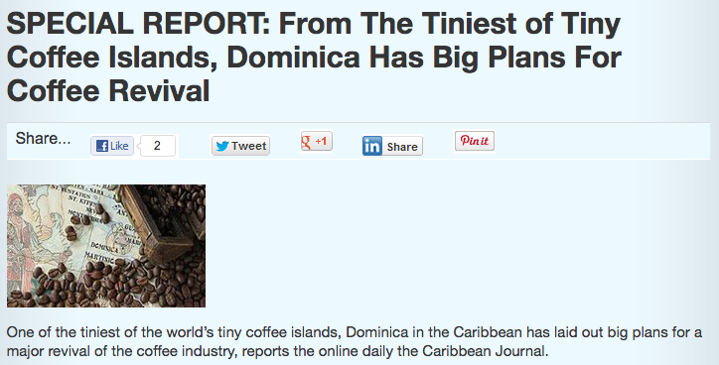
Graduate Writing Center: gwrc@ucr.edu
Individual Consultations
Online resources (pre-writing, worksheets, etc.)
Fulbright Student Program Website: us.fulbrightonline.org
Updated guidelines
Pre-writing prompts
Country specific information
Director, UCR GradSuccess: Maggie Gover, maggie.gover@ucr.edu, (951)
Position Yourself for Success
Start thinking now about which countries you might be interested in
Be creative with research focus
Interested in coffee producing revival:
Notes:
They have one or two people at Fulbright for each of the REGIONS, not the countries, so keep that in mind if you have questions
Remember to be flexible: if you wanted to do a project on reviving coffee production in the Caribbean, you might have thought applying for Dominica was a great idea

