Slide 1
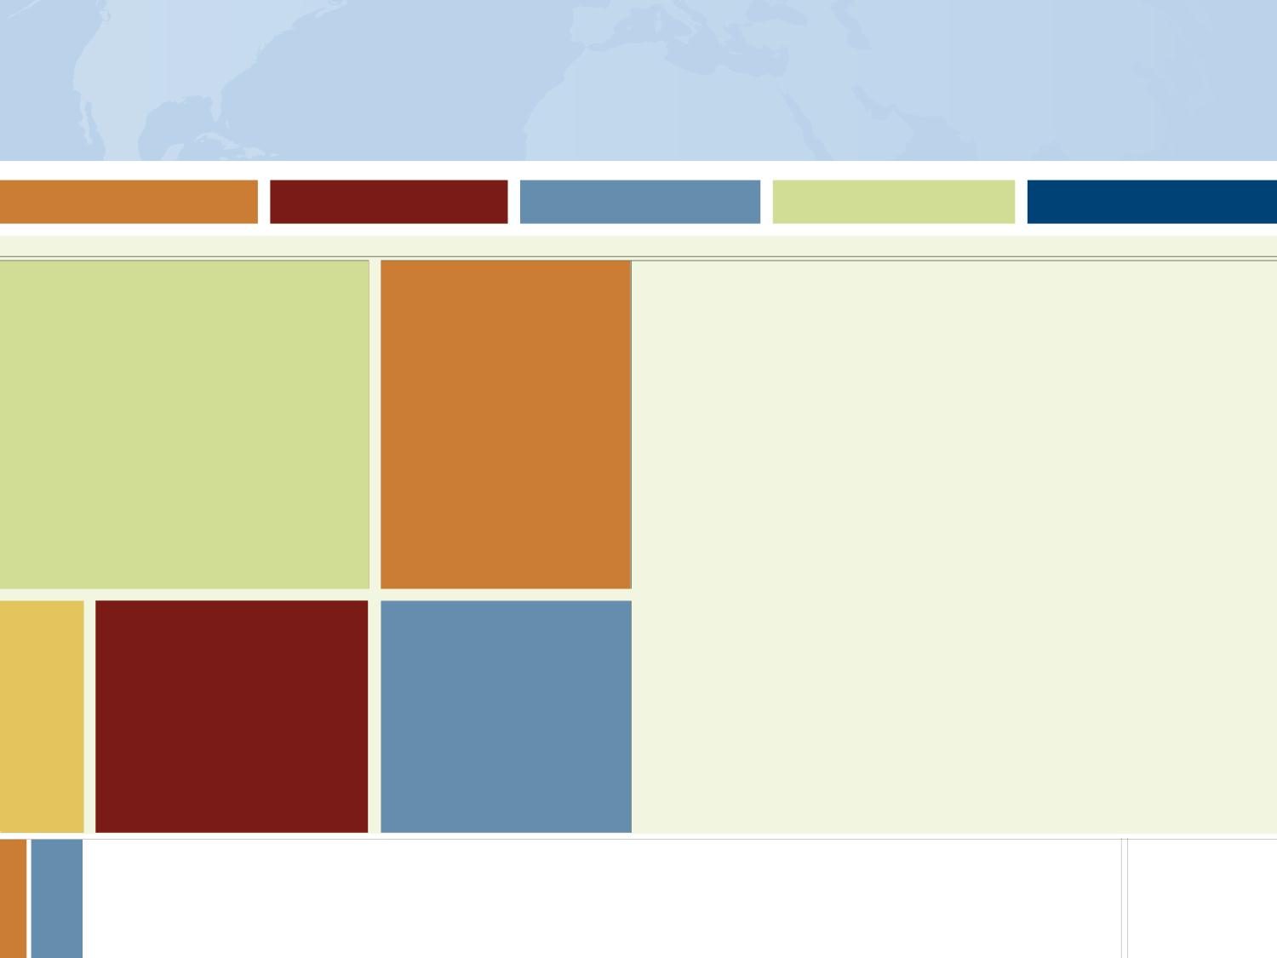

Special Award Opportunities:
Critical Language Enhancement Award
3-6 month pre-grant add-on for study of a “critical language”
Languages: Arabic, Bahasa Indonesia, Bengali/Bangla, Chinese (Mandarin only), Gujarati, Hindi, Marathi, Punjabi, Russian, Urdu
Countries: Morocco, Jordan, Egypt, Indonesia, India, China (mainland only), Russia
Notes:
Supplementary funding for Fulbright U.S. Student Program grantees – only available in these languages, in these countries (on-site prelim language training)
Fulbright-National Geographic competition is currently on hold.

Slide 2
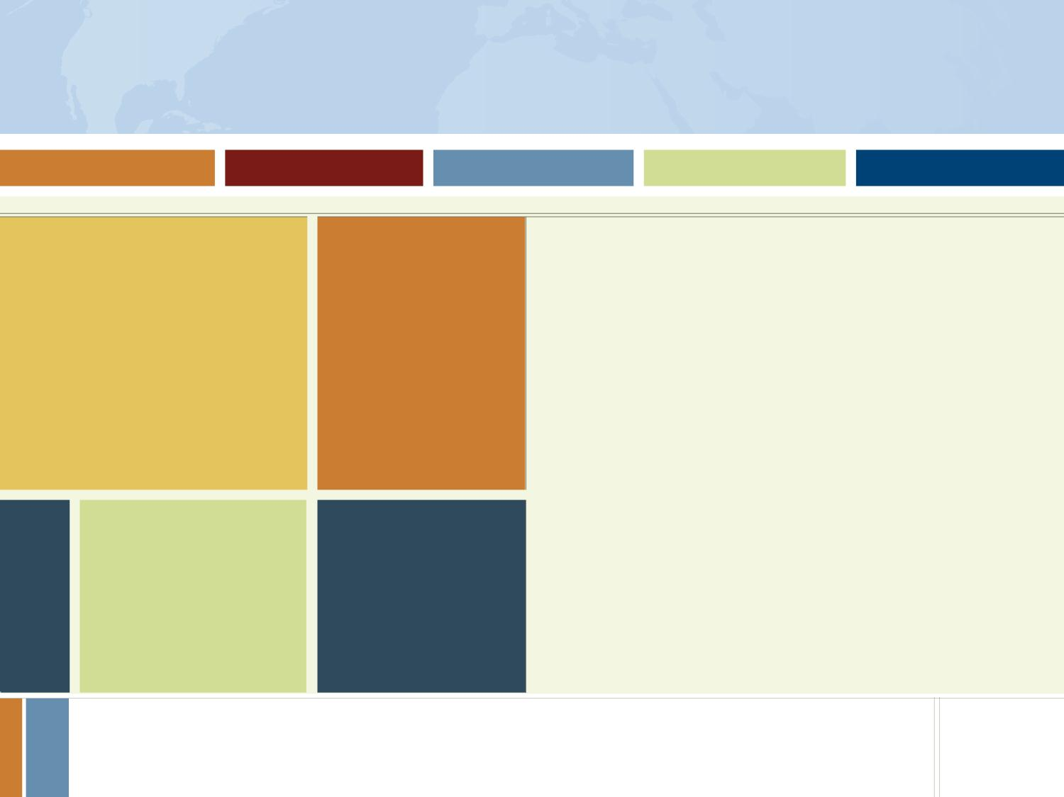
What are they looking for?
Cultural Ambassadorship
People who will create a positive impression of the US
People who are genuinely interested in learning more about other cultures
Personable, interesting people
For research: knowledgeable about the culture and region which they are applying to study
Quality/feasibility of proposal
Extent to which candidate/ project furthers Fulbright goals
Individual country requirements
FFSB preference factors
Language preparation
Academic/professional record
Desirability of achieving diversity
Personal qualifications
Notes:
FFSB = Fulbright Fulbright Foreign Scholarship Board
Fulbright goals (cultural ambassadorship)
Personal qualifications (leadership and service)
Specific country goals

Slide 3
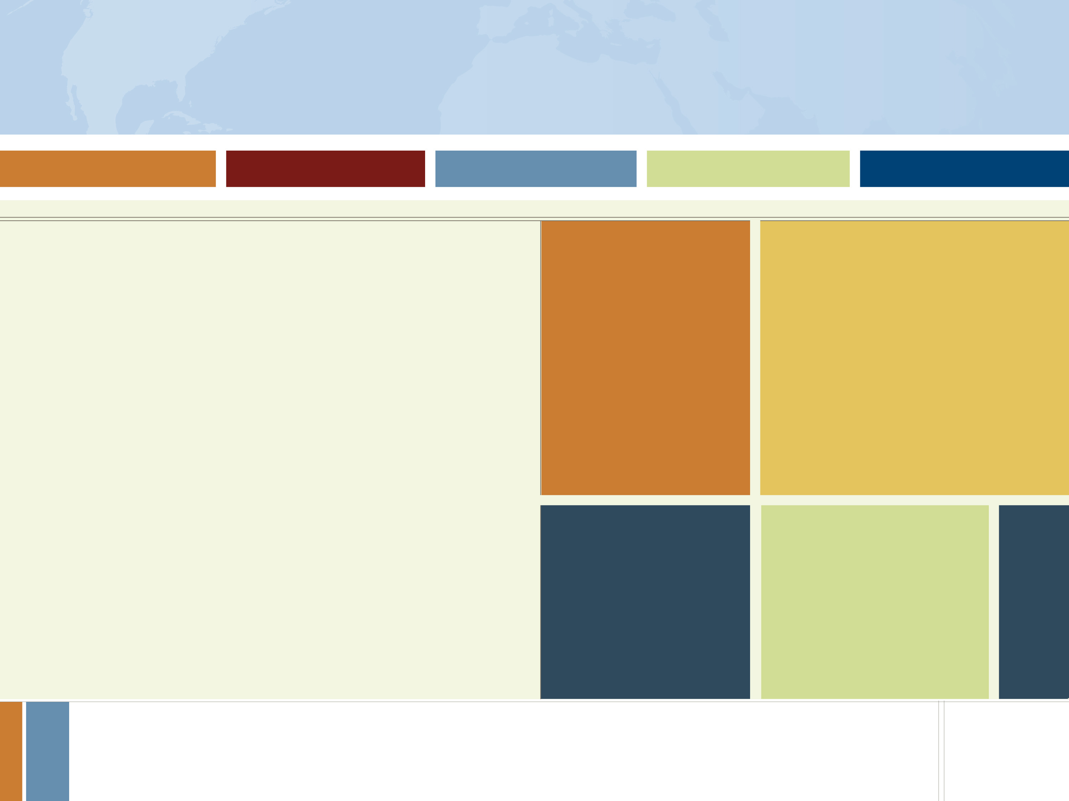
Application Components
Basic Personal Data
Essays
  Statement of Purpose
    Research/Study: 2 page max
    ETA: 1 page max
  Personal Statement (1 page max)
Reports / References
  Foreign Language Evaluation
  Three (3) Recommendations
Transcripts
Other
  Research/Study: Affiliation Letter(s)
  Arts: Supplementary Materials
Notes:
Language evaluation – you ask someone to do it for you, they receive an automatic request from Fulbright
They have to meet with you, speak with you, and upload their assessment of your abilities (show enrollment in classes, trajectory of improvement)

Slide 4
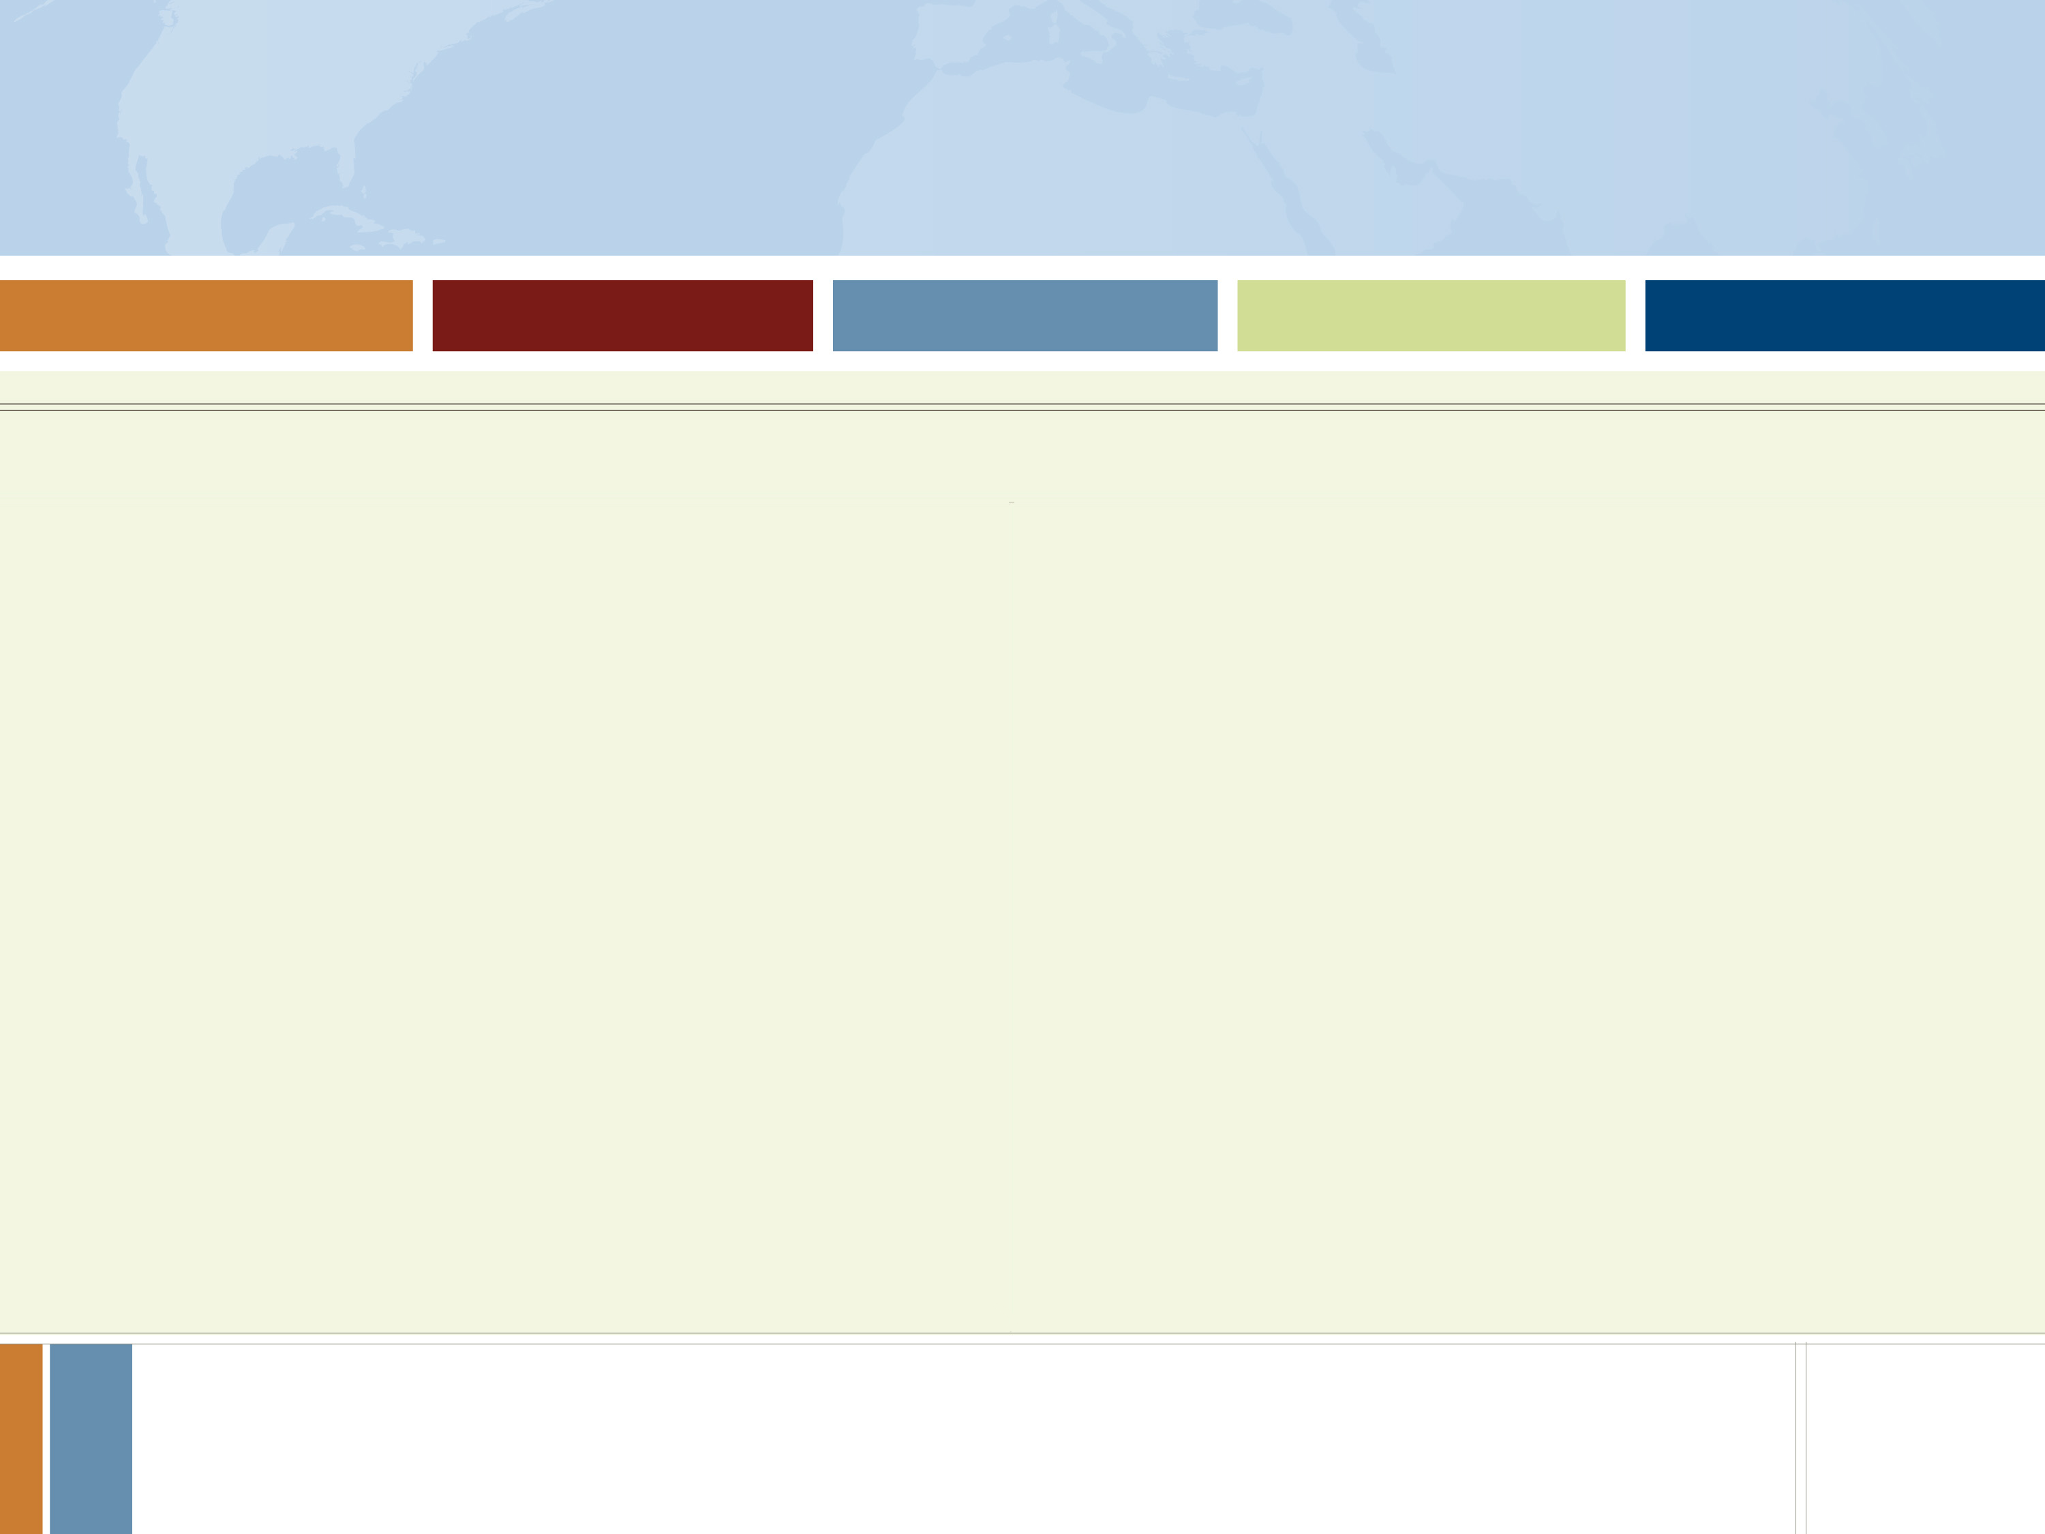

Letters of Affiliation
Host country contact who will advise and/or mentor you
Professional at a university, laboratory, library, community org, etc.
Requirements vary by country
Signed letter, on letterhead, in application
ETAs DO NOT secure affiliations
Notes:
For study/research and arts projects only, not ETAs

Slide 5

How to Apply
Complete On-line Application
Currently-Enrolled Applicants
References & Lang. Evaluation submitted online by referrers
Letters of affiliation scanned & uploaded by you
Transcripts (unofficial) uploaded by you
Must apply through campus Fulbright Program Advisor
Campus deadlines apply
Campus interview required
Notes:
Application Tips section can be found in Applicants section on us.fulbrightonline.org

